Slide 1


Slide 2
The CPU
Scott CPU 2 - The Control Unit & Memory

Slide 3
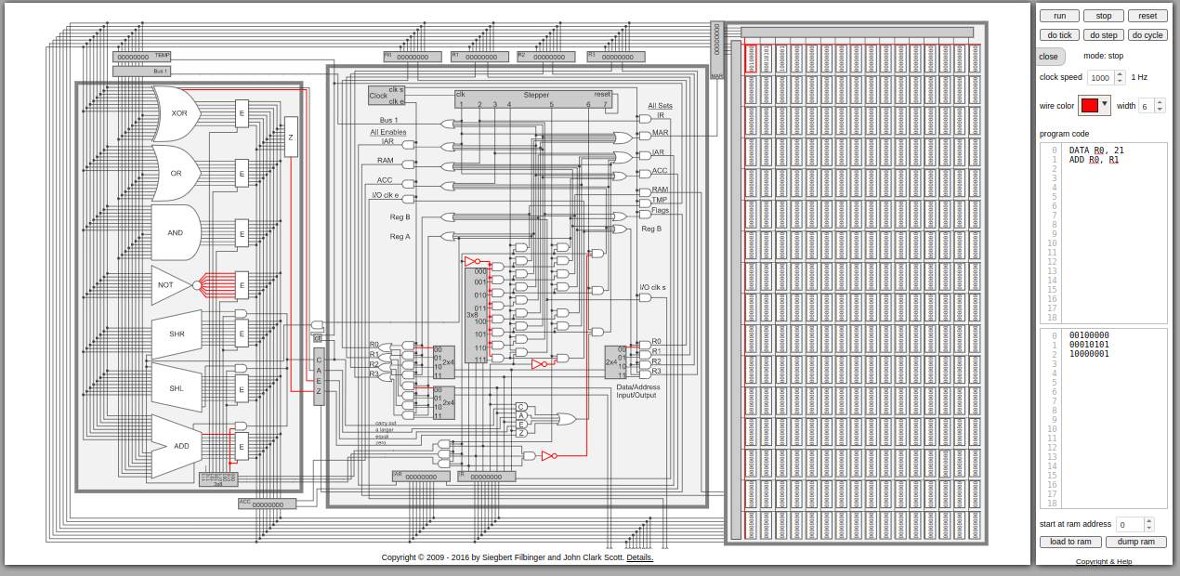
Last Lecture
Overview of the Scott CPU
Bus
ALU
Registers
Started looking at the clock
Notes:
Can be found online… but I can’t link to it

Slide 4
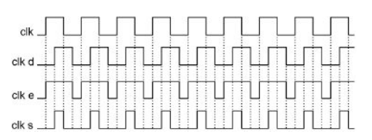
The Control Unit
The Clock (Review)
Recall that there are three (well, four) clocks in play
Clk - the cpu clock
Clk d - a hidden clock half-offset
Clk e - the enable clock
Clk s - the set clock
For every cycle of Clk, Clk e and Clk s enable as well
Notes:
Can be found online… but I can’t link to it

Slide 5
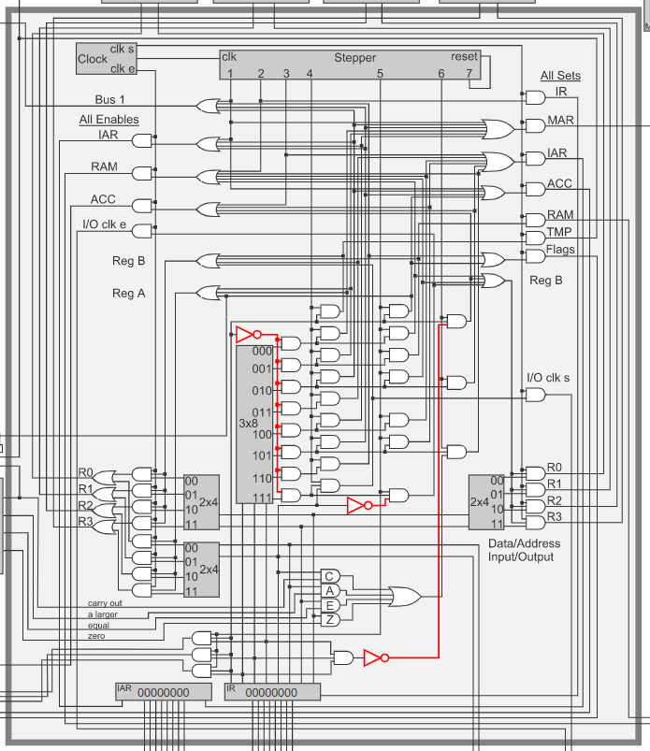
The Control Unit
The Stepper
Here again is the control unit of the Scott CPU
Note that the clock is attached to three different things:
Clk s - attached to the set-side logic
Clk e - attached to the enable side logic
Clk - attached to something labeled “Stepper”
Notes:
Can be found online… but I can’t link to it

Slide 6
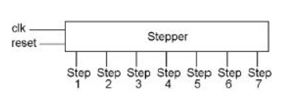
The Control Unit
What’s a stepper?
The stepper is a bit of digital logic that enables one outgoing wire
The outgoing wire activated moves to the next step on every clock cycle
When the last step is reached, it resets, thus cycling through each output
Notes:
Can be found online… but I can’t link to it

Slide 7
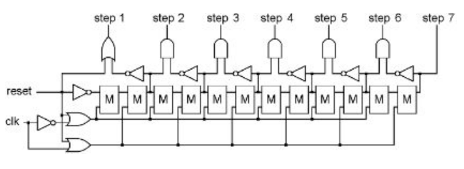
The Control Unit
Internally this can be implemented using the following logical setup
Don’t worry about the details, just appreciate how cool it is that someone thought of this
Now we have a steady drumbeat of signals to make things go
Notes:
Can be found online… but I can’t link to it

Slide 8
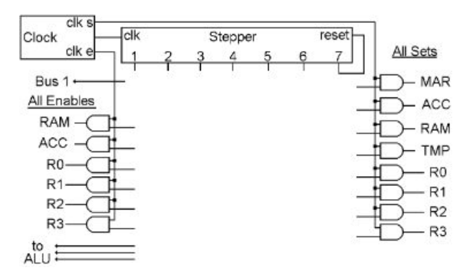
The Control Unit
We can focus in on the stepper, the enables and the sets
Recall that for each step, the Clk e and Clk s signals will be enabled
So each step has an opportunity to move data from one place to another on the bus
Notes:
Can be found online… but I can’t link to it

Slide 9
The Control Unit
Let’s consider a very simple operation: adding R0 to R1
What steps would need to happen for this to occur?
R1 moved to TMP
R0 sent through ALU (with TMP) to ACC
ACC moved to R0
Notes:
Can be found online… but I can’t link to it

Slide 10
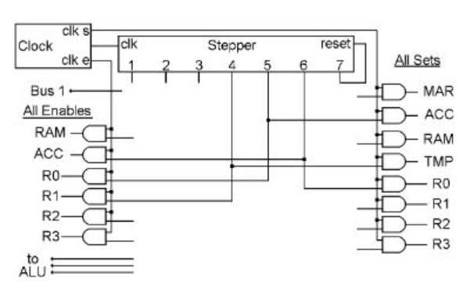
The Control Unit
If you look closely at the wiring here, this is accomplished in steps 4, 5 and 6
For each step, a location is enabled and a location is set via an AND gate tied to the stepper, and the appropriate clock
Assuming that the ALU add was enabled as well, R0 now holds the sum of R0 and R1!
Notes:
Can be found online… but I can’t link to it

Slide 11
The Control Unit
We can move pretty much any data from anywhere to anywhere, using the same technique
Of course we don’t want to hard wire these paths into the stepper, do we?
Instead we want to enable them conditionally, based on… an instruction
Notes:
Can be found online… but I can’t link to it

Slide 12
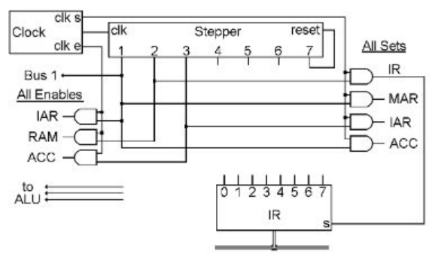
The Control Unit
And here we get to the crux of the Control Unit: the Instruction Register and the Instruction Address Register
Instruction Register - holds the current instruction
Instruction Address Register - holds the address of the current instruction
Notes:
Can be found online… but I can’t link to it

Slide 13
The Control Unit
The first three steps of the stepper are always the same
1 - enable the IAR and send it to the Memory Address Register
Also bump the MAR and store it in the accumulator
2 - enable the memory value at that location onto the bus and set it to the instruction register
3 - load the ACC into the IAR
Notes:
Can be found online… but I can’t link to it

Slide 14
The Control Unit
Note that in step 1 there is also that funny Bus 1 thing
Makes a value of 1 available to the ALU immediately (no bus)
This allows the ALU to immediately add 1 to the instruction address, bumping it to the next value and saving it in the accumulator
So after step 3 we have the next instructions address in the IAR
Notes:
Can be found online… but I can’t link to it

Slide 15
The Control Unit
So the first three steps of the stepper load the next instruction into the Instruction Register and bump the IAR to the next value
Pretty cool!
Now what?
Now let’s look at an actual instruction
Notes:
Can be found online… but I can’t link to it

Slide 16
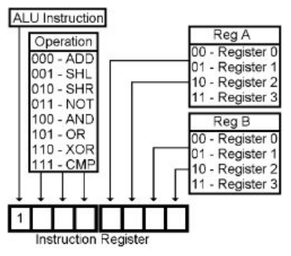
The Control Unit
Instructions are just binary 1’s and 0’s
Here is the schema for ALU instructions
Always starts with a 1
Next three bits are the OP
Next two bits are register A (read)
Next two bits are register B (read and written to)
Notes:
Can be found online… but I can’t link to it

Slide 17
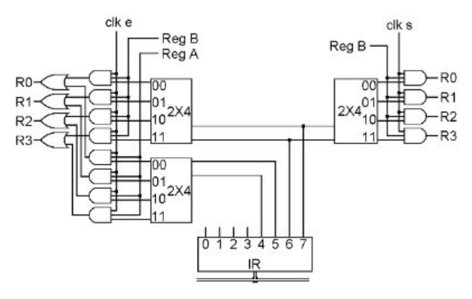
The Control Unit
How can we make the registers we hard-wired earlier be enabled and set when needed?
We can use a 2x4 decoder, decoding 2 bits into one of four registers!
Notes:
Can be found online… but I can’t link to it

Slide 18
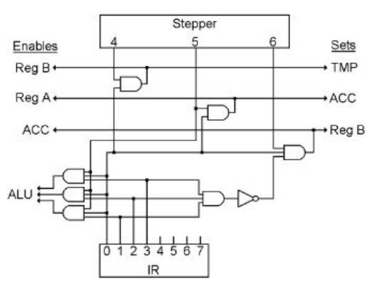
The Control Unit
Now the stepper can be wired in to this whole scheme as well
Notes:
Can be found online… but I can’t link to it

Slide 19
The Control Unit
If the first instruction bit is 1 then
Step 4: Enable Register B in and move it to TMP (selecting from bits 6 and 7)
Step 5: Enable Register A and send it through the ALU (to be operated on with TMP) to ACC
Step 6: Enable ACC and send the value to Register B
Notes:
Can be found online… but I can’t link to it

Slide 20
The Control Unit
Note the output of bits 1, 2 and 3 to the ALU
Recall the ALU setup
Notes:
Can be found online… but I can’t link to it

Slide 21
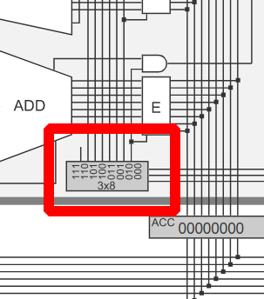
The Control Unit
Note the output of bits 1, 2 and 3 to the ALU
Recall the ALU setup: it has a decoder as well, which is connected to an enabler for the specified operation
So the value put on the bus will run through the correct operation with the value in TMP and be written to ACC
Notes:
Can be found online… but I can’t link to it

Slide 22
The Control Unit
Pretty incredible, isn’t it?
OK, so what has happened here?
Based on an instruction, we have properly moved data through our CPU to add two registers
We decoded the instruction and executed it, 3 easy steps (4, 5 & 6)
Notes:
Can be found online… but I can’t link to it

Slide 23
The Control Unit
And not only that, but in steps 1, 2 and 3, we bumped the IAR, so that on the next clock cycle we will do the same darned thing with the next instruction
Notes:
Can be found online… but I can’t link to it

Slide 24
The Control Unit
OK, enough, let’s look at a demo of a simple OR in the online simulator, so you can see what’s going on… DEMO TIME
Notes:
Can be found online… but I can’t link to it

Slide 25
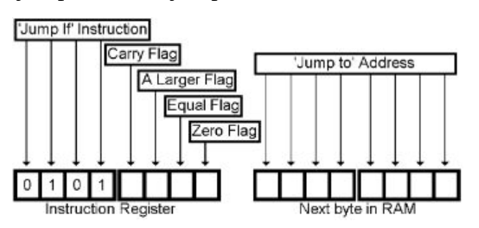
The Control Unit
OK, what about jumps? We don’t want to just linearly execute instructions, right?
Of course!
So let’s look now at a conditional jump instruction
Notes:
Can be found online… but I can’t link to it

Slide 26
The Control Unit
The Jump If instruction is too large to fit into a single byte
First byte - first four bits are the code for the instruction
Next four bytes select the condition to test in the FLAGS register
Second byte - the address to jump to
Notes:
Can be found online… but I can’t link to it

Slide 27
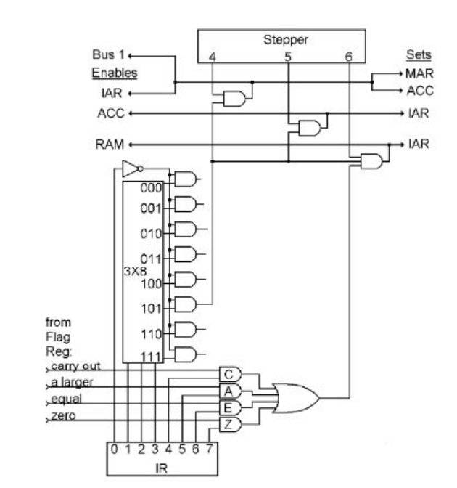
The Control Unit
Wiring looks a little hairy, but the first four bits are just selecting the logic shown
Next four bits are ANDed with the values from FLAGS
Notes:
Can be found online… but I can’t link to it

Slide 28
The Control Unit
Now look at the steps, assuming this instruction is enabled
Step 4: Enable bus 1 and IAR, setting MAR and ACC
Note: ACC is IAR + 1 where MAR is just IAR
Step 5: Move ACC to IAR
Step 6: If the flags match up, move memory to IAR
Notes:
Can be found online… but I can’t link to it

Slide 29
The Control Unit
Pretty bonkers, but it all works out
If the flags aren’t matched, then IAR points to the next byte past where the conditional address was
Some very smart folks thought all this up kids
Notes:
Can be found online… but I can’t link to it

Slide 30
The Control Unit
The Scott CPU has other some other instructions
Data
Load/Store
They are just more of the same
Enabling the right locations and setting the right locations, based on the instruction in IR
Notes:
Can be found online… but I can’t link to it

Slide 31
The Control Unit
The Scott CPU has a pretty clear fetch stage (steps 1-3)
The Decode and Execute stages are a bit smeared into one another, but that’s OK, they are smeared into one another in real CPUs too
Notes:
Can be found online… but I can’t link to it

Slide 32
The Control Unit
Pretty cool, we have gotten down to brass tacks here
IT’S JUST LIGHTNING RUNNING THROUGH SAND
Notes:
Can be found online… but I can’t link to it

Slide 33
The Control Unit
Modern CPUs
The Scott CPU is obviously very simplified
Note that only one instruction at a time is being fetched and executed
7 cycles per instruction
Notes:
Can be found online… but I can’t link to it

Slide 34
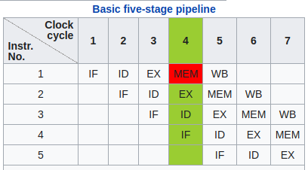
The Control Unit
Modern CPUs feature pipelining: multiple instructions executing at once, in various stages
IF - instruction fetch
ID - instruction decode
EX - instruction execute
MEM - memory access
WB - register write back
Notes:
Can be found online… but I can’t link to it

Slide 35
The Control Unit
This is instruction parallelism
Multiple instructions are executing at the same time
Note that we are finishing (retiring) one instruction per clock cycle
A lot better retiring one instruction every seven clock cycles in the Scott CPU!
Notes:
Can be found online… but I can’t link to it

Slide 36
The Control Unit
Obviously this requires much more sophisticated engineering to keep all these instructions in flight
Notes:
Can be found online… but I can’t link to it

Slide 37
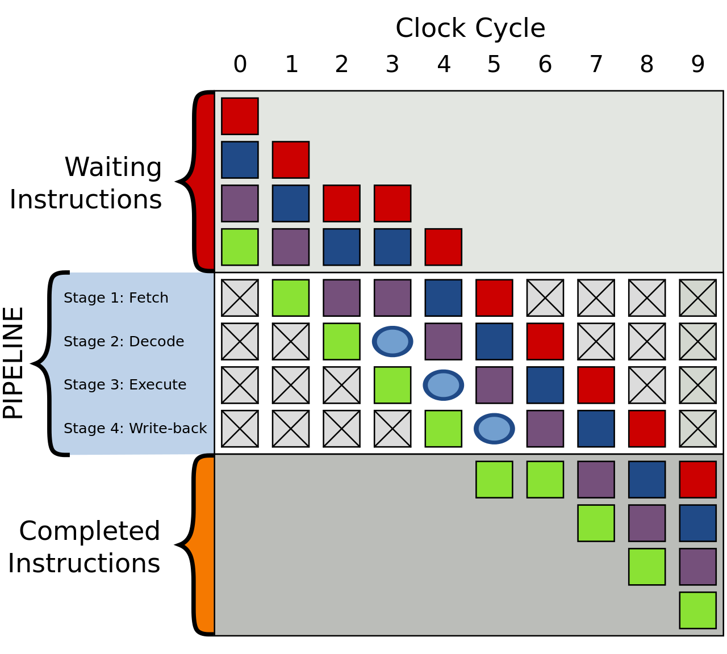
The Control Unit
All is not perfect, however
Some instructions depend on the results of other instructions
Some stages may take longer than a clock cycle to complete
Here is an example of a stall caused by an instruction staying in the fetch stage for an extra cycle
Notes:
Can be found online… but I can’t link to it

Slide 38
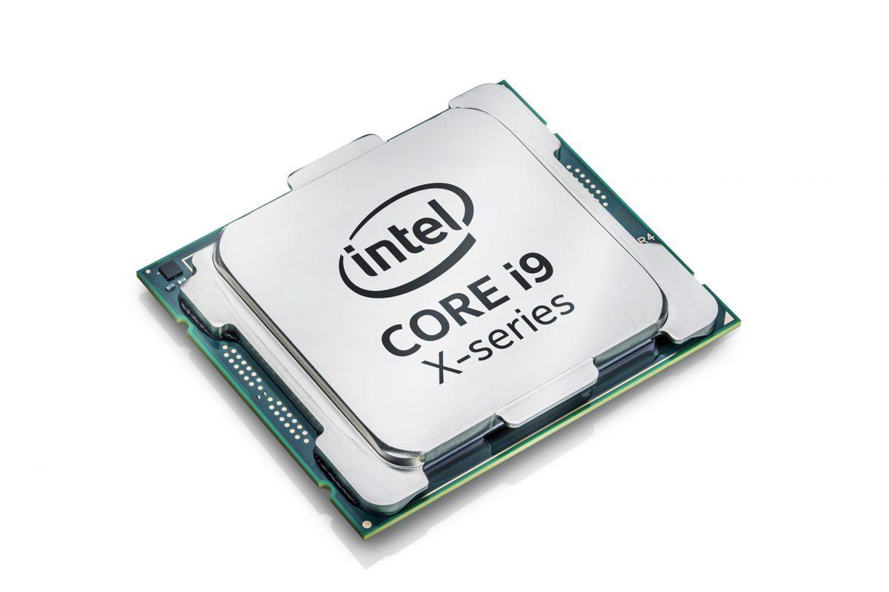
The Control Unit
This is an extremely sophisticated machine
Perhaps the most sophisticated machine ever mass produced
But it still operates on the same basic principles as the Scott CPU
Notes:
Can be found online… but I can’t link to it

Slide 39
The CPU
Whew!
Today we got down to brass tacks and looked at how the Control Unit works
The stepper marches things along in various stages
Each stage allows movement of data from one place to another
The control unit has logic that decodes instructions into something the ALU, etc. can act on
And on and on it goes...
We also briefly considered pipelining in modern CPUs
Next time: memory!

